Slide 1
First Order Logic

Slide 2
Big Ideas
Logic is a great knowledge representation language for many AI problems
Propositional logic is the simple foundation and fine for some AI problems
First order logic (FOL) is much more expressive as a KR language and more commonly used in AI

Slide 3
Examples of PL sentences
(P ∧ Q) ⇒ R
  “If it is hot and humid, then it is raining”
Q ⇒ P
  “If it is humid, then it is hot”
Q
  “It is humid.”
We’re free to choose better symbols
  Ho = “It is hot”
  Hu = “It is humid”
  R = “It is raining”

Slide 4
Problems with
Propositional Logic

Slide 5
Propositional logic: pro and con
Advantages
  Simple KR language sufficient for some problems
  Lays the foundation for higher logics (e.g., FOL)
  Reasoning is decidable, though NP complete, and efficient techniques exist for many problems
Disadvantages
  Not expressive enough for most problems

Slide 6
PL is a weak KR language
Hard to identify “individuals” (e.g., Mary, 3)
Can’t directly talk about properties of individuals or relations between individuals (e.g., “Bill is tall”)
Generalizations, patterns, regularities can’t easily be represented (e.g., “all triangles have 3 sides”)
First-Order Logic (FOL) is expressive enough to represent this kind of information using relations, variables and quantifiers, e.g.,
    Every elephant is gray: ∀ x (elephant(x) ⇒ gray(x))
    There is a white alligator: ∃ x (alligator(X) ^ white(X))

Slide 7
PL Example
Consider the problem of representing the following information:
  Every person is mortal.
  Confucius is a person.
  Confucius is mortal.
How can these sentences be represented so that we can infer the third sentence from the first two?

Slide 8
PL Example
In PL we have to create propositional symbols to stand for all or part of each sentence, e.g.:
  P = “person”; Q = “mortal”; R = “Confucius”
The above 3 sentences are represented as:
  P ⇒ Q; R ⇒ P; R ⇒ Q
The 3rd sentence is entailed by the first two, but we need an explicit symbol, R, to represent an individual, Confucius, who is a member of the classes person and mortal
Representing other individuals requires introducing separate symbols for each, with some way to represent the fact that all individuals who are “people” are also “mortal”

Slide 9
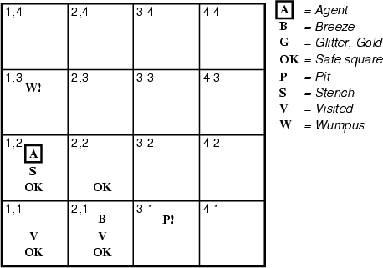
Hunt the Wumpus domain
Some atomic propositions:
  S12 = There is a stench in cell (1,2)
  B34 = There is a breeze in cell (3,4)
  W22 = Wumpus is in cell (2,2)
  V11 = We’ve visited cell (1,1)
  OK11 = Cell (1,1) is safe.
  …
Some rules:
  (R1) ¬S11 ⇒ ¬W11 ∧ ¬ W12 ∧ ¬ W21
  (R2) ¬ S21 ⇒ ¬W11 ∧ ¬ W21 ∧ ¬ W22 ∧ ¬ W31
  (R3) ¬ S12 ⇒ ¬W11 ∧ ¬ W12 ∧ ¬ W22 ∧ ¬ W13
  (R4) S12 ⇒ W13 ∨ W12 ∨ W22 ∨ W11
  …
The lack of variables requires us to give similar rules for each cell!

Slide 10
Propositional Logic- limitations
Lack of variables prevents stating more general rules
  We need a set of similar rules for each cell
Change of the KB over time is difficult to represent
  Standard technique is to index facts with the time when they’re true
  This means we have a separate KB for every time point

Slide 11
Representation Languages

Slide 12
Background
Programming languages as Formal Languages:
Programming languages (such as C++ or Java) are formal languages
Programs themselves represent, in a direct sense, only computational processes.
Data structures within programs can represent facts;
Ex: a program could use a 4 x 4 array to represent the contents of the wumpus world.
Thus, the programming language statement World[2,2] = Pit is a way to assert that there is a pit in square [2,2].
Issues?
Such representations might be considered ad hoc

Slide 13
Background
database systems
database systems provide a general, domain-independent way to store and retrieve facts.
procedural nature of programming language vs. declarative nature of propositional logic
1. programming languages lack any general mechanism for deriving facts from other facts;
  each update to a data structure is done by a domain-specific procedure whose details are derived by the programmer from his own knowledge of the domain.
propositional logic - declarative nature in which knowledge and inference are separate, and inference is entirely domain independent

Slide 14
Background
procedural nature of programming language vs. declarative nature of propositional logic
2. A second drawback of data structures in programs and of databases
is the lack of any easy way to say
  "There is a pit in [2,2] or [3,1]"
  "If the wumpus is in [1 ,1] then it is not in [2,2]."
Programs can store a single value for each variable (or even allow the value to be "unknown”)
  but they lack the expressiveness required to handle partial information.

Slide 15
Propositional logic
Propositional logic is a declarative language
  because its semantics is based on a truth relation between sentences and possible worlds.
It has sufficient expressive power to deal with partial information using disjunction and negation.
Propositional logic has a third property compositionality
  In a compositional language, the meaning of a sentence is a function of the meaning of its parts.
  Ex: the meaning of "S 1,4 ^ S 1,2" is related to the meanings of "S1, 4" and “S1, 2"

Slide 16
Propositional logic vs. English
propositional logic lacks the expressive power to concisely describe an environment with many objects.
  Ex: we need to write a separate rule about breezes and pits for each square, such as B1,1 ⇔ (P1,2 V P2,1)
English:
Natural languages are very expressive
  We can easily say, "Squares adjacent to pits are breezy."
  The syntax and semantics of English make it possible to describe the environment concisely.
Natural languages suffer from ambiguity, a problem for a representation language.
Origin of FOL?

Slide 17
Combining the best of formal and natural languages
adopt the foundation of propositional logic
  a declarative, compositional semantics that is context-independent and unambiguous
  and build a more expressive logic on that foundation
borrowing representational ideas from natural language
  while avoiding its drawbacks

Slide 18
Pros and cons of propositional logic - Summary
Propositional logic is declarative
  - Knowledge and inference are separate
☺ Propositional logic allows partial/disjunctive/negated information
  unlike most programming languages and databases
Propositional logic is compositional:
  meaning of B_{1,1} ∧ P_{1,2} is derived from meaning of B_{1,1} and of P_{1,2}
☺ Meaning in propositional logic is context-independent
  unlike natural language, where meaning depends on context
☹ Propositional logic has limited expressive power
  unlike natural language
  E.g., cannot say "pits cause breezes in adjacent squares“
    except by writing one sentence for each square

Slide 19
FOL

Slide 20
Elements of English Language
Nouns and noun phrases that refer to objects (squares, pits) and
verbs and verb phrases that refer to relations among objects (is breezy, is adjacent to, shoots).
Some of these relations are functions-relations in which there is only one "value" for a given "input"
Ex:
Objects: people, houses, numbers, theories, Ronald McDonald, colors, baseball games, wars, centuries . . .
Relations:
  these can be unary relations or properties such as red, round, prime, multistoried . . ., or
  more general n-ary relations such as brother of, bigger than, inside, part of, has color, occurred after, owns, comes between, . . .
Functions: father of, best friend, third inning of, one more than, beginning of . . .

Slide 21
First-Order Logic
Propositional logic assumes the world contains facts
First-order logic (like natural language) assumes the world contains
  Objects: people, houses, numbers, colors, baseball games, wars, …
  Relations: red, round, prime, brother of, bigger than, part of, comes between, …
  Functions: father of, best friend, one more than, plus, …

Slide 22
First-Order Logic
The language of first-order logic
  is built around objects and relations.
everyday we deal with objects and the relations among them.
  First-order logic can express facts about some or all of the objects in the universe.
  This enables one to represent general laws or rules, such as the statement "Squares neighboring the wumpus are smelly."

Slide 23
Examples
"One plus two equals three."
Objects: one, two, three, one plus two;
Relation: equals;
Function: plus. ("One plus two" is a name for the object that is obtained by applying the function "plus" to the objects "one" and "two." "Three" is another name for this object.)

Slide 24
Examples
"Squares neighboring the wumpus are smelly."
Objects: wumpus, squares;
Property: smelly;
Relation: neighboring.
"Evil King John ruled England in 1200."
Objects: John, England, 1200;
Properties: evil, king.
Relation: ruled;

Slide 25
Ontological commitment
Ontological commitment
Mathematically, expressed through the nature of the formal models with respect to which the truth of sentences is defined.
propositional logic
  propositional logic assumes that there are facts that either hold or do not hold in the world.
  Each fact can be in one of two states: true or false, and
  each model assigns true or false to each proposition symbol
First-order logic
  First-order logic assumes that the world consists of objects with certain relations among them that do or do not hold.
  The formal models are correspondingly more complicated than those for propositional logic.

Slide 26
Epistemological commitments
epistemological commitments
A logic can also be characterized by its epistemological commitments
the possible states of knowledge that it allows with respect to each fact.
In both propositional and first order logic
  a sentence represents a fact and
  the agent either believes the sentence to be true, believes it to be false, or has no opinion.
These logics therefore have three possible states of knowledge regarding any sentence.

Slide 27
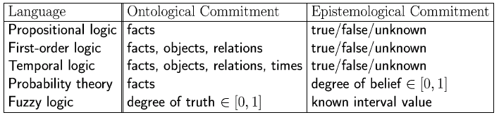
Logics in General
Ontological Commitment:
  What exists in the world — TRUTH
  PL : facts hold or do not hold.
  FOL : objects with relations between them that hold or do not hold
Epistemological Commitment:
  What an agent believes about facts — BELIEF

Slide 28
SYNTAX AND SEMANTICS OF FIRST-ORDER LOGIC
To study
How the language facilitates concise representations
How its semantics leads to sound reasoning procedures.

Slide 29
Models for first-order logic
The models of a logical language
are the formal structures that constitute the possible worlds under consideration.
  Each model links the vocabulary of the logical sentences to elements of the possible world so that the truth of any sentence can be determined.
models for propositional logic
models for propositional logic link proposition symbols to predefined truth values.
Models for first-order logic ?

Slide 30
Models for first-order logic
Models for first-order logic
The domain of a model is the set of objects or domain elements it contains.
The domain is required to be nonempty -- every possible world must contain at least one object.
Mathematically,
  it doesn't matter what these objects are
  all that matters is how many there are in each particular model

Slide 31
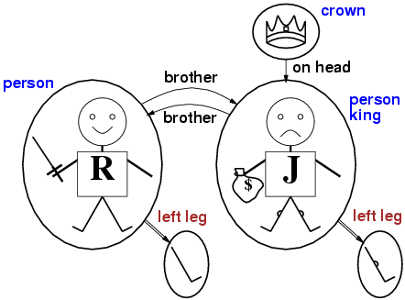
Models for FOL: Example
Objects: by circles : #5 Binary relation: by labels in black font : #2
Function: by labels in red font:#1 Unary relation: by labels in blue font:#3

Slide 32
Models for FOL: Example
A model for FOL: objects
five objects:
  Richard the Lionheart, King of England from 1189 to 1199;
  his younger brother, the evil King John, who ruled from 1199 to 1215;
  the left legs of Richard and John;
  a crown.

Slide 33
Models for FOL: Example
A model for FOL: relations
Formally, a relation is the set of tuples of objects that are related.
(A tuple is a collection of objects arranged in a fixed order and is written with angle brackets surrounding the objects)
Ex: Richard and John are brothers.
Thus, the brotherhood relation in this model is the set
{ (Richard the Lionheart, King John), (King John, Richard the Lion heart) } ---(1)

Slide 34
Models for FOL: Example
A model for FOL: binary relations
two binary relations: "brother" and "on head" relations relating pairs of objects
Ex: The crown is on King John's head
"on head" relation contains one tuple, (the crown, King John).

Slide 35
Models for FOL: Example
A model for FOL: unary relations or properties
three unary relations:
the "person" property is true of both Richard and John;
the "king" property is true only of John (presumably because Richard is dead at this point);
the "crown" property is true only of the crown.

Slide 36
Models for FOL: Example
A model for FOL: Functions
one unary function: left-leg
Certain kinds of relationships are best considered as Functions in that a given object must be related to exactly one object in this way.
Ex: each person has one left leg
so the model has a unary "left leg" function that includes the following mappings:
(Richard the Lionheart) -> Richard's left leg (2)
(King John) -> John's left leg

Slide 37
Models for FOL: Example
A model for FOL: Functions
models in first-order logic require total functions
total functions: there must be a value for every input tuple.
Thus, the crown must have a left leg and so must each of the left legs.

Slide 38
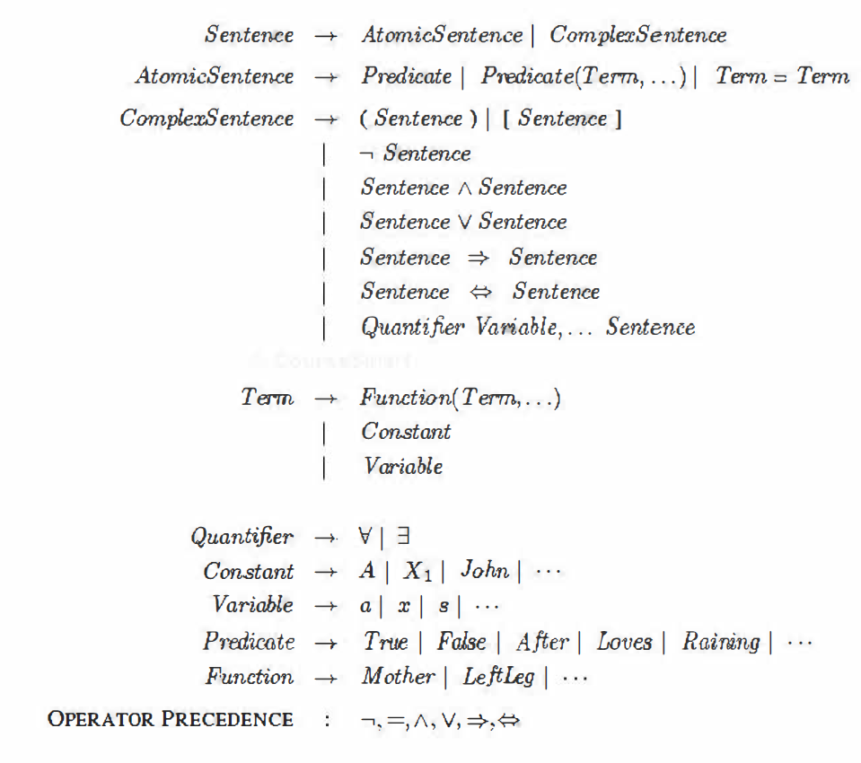
syntax of first-order logic in BNF form
Operator precedence from highest to lowest

Slide 39
syntax of first-order logic
The basic syntactic elements of first-order logic
symbols that stand for objects, relations, and functions.
The symbols, therefore, come in three kinds:
  constant symbols, which stand for objects;
  predicate symbols, which stand for relations;
  and function symbols, which stand for functions.
Convention: begin symbols with uppercase letters.
Ex:
  constant symbols: Richard and John;
  predicate symbols: Brother, OnHead, Person, King, and Crown
  function symbol: LeftLeg.
Note: Each predicate and function symbol comes with an arity that fixes the number of arguments.

Slide 40
syntax of first-order logic - interpretation
interpretation
As in propositional logic, every model must provide the information required to determine if any given sentence is true or false.
Thus, in addition to its objects, relations, and functions, each model includes an interpretation that specifies exactly which objects, relations and functions are referred to by the constant, predicate, and function symbols.
One possible interpretation which a logician would call is the intended interpretation

Slide 41
syntax of first-order logic - interpretation
intended interpretation
  Richard refers to Richard the Lionheart and
  John refers to the evil King John.
  Brother refers to the brotherhood relation, that is, the set of tuples of objects given in (1)
  OnHead refers to the "on head" relation that holds between the crown and King John;
  Person, King, and Crown refer to the sets of objects that are persons, kings, and crowns.
  LeftLeg refers to the "left leg" function, that is, the mapping given in (2)

Slide 42
syntax of first-order logic - interpretation
other possible interpretations
There are many other possible interpretations
Notice that not all the objects need have a name
Ex: the intended interpretation does not name the crown or the legs.
It is also possible for an object to have several names;
This is similar to propositional logic in which It is perfectly possible to have a model in which Cloudy and Sunny are both true;
  it is the job of the knowledge base to rule out models that are inconsistent with our knowledge.

Slide 43
syntax of first-order logic -Summary
Summary: model in first-order logic
consists of a set of objects and
an interpretation that maps
  constant symbols to objects,
  predicate symbols to relations on those objects, and
  function symbols to functions on those objects.
Just as with propositional logic, entailment, validity, and so on are defined in terms of all possible models.

Slide 44
syntax of first-order logic -Summary
Summary: model in first-order logic
models vary
  in how many objects they contain- from one up to infinity-and
  in the way the constant symbols map to objects.
If there are two constant symbols and one object,
  then both symbols must refer to the same object;
but this can still happen even with more objects. When there are more objects than constant symbols,
  some of the objects will have no names.

Slide 45
syntax of first-order logic -Summary
Summary: model in first-order logic
Because the number of possible models is unbounded
  checking entailment by the enumeration of all possible models is not feasible for first-order logic (unlike propositional logic).
Even if the number of objects is restricted, the number of combinations can be very large.

Slide 46
syntax of first-order logic- Terms
Term
A term is a logical expression that refers to an object.
Constant symbols are therefore terms, but it is not always convenient to have a distinct symbol to name every object.
function symbols : instead of using a constant symbol, we use LeftLeg(John).
  Ex: English we use the expression "King John's left leg" rather than giving a name to his leg.

Slide 47
syntax of first-order logic- Terms
Term : general case
a complex term is formed by a function symbol followed by a parenthesized list of terms as arguments to the function symbol.
Note: terms are not same as "subroutine call" that "returns a value."
  There is no LeftLeg subroutine that takes a person as input and returns a leg.
  We can reason about left legs (e.g., stating the general rule that everyone has one and then deducing that John must have one) without ever providing a definition of LeftLeg.
  This cannot be done with subroutines in programming languages

Slide 48
syntax of first-order logic
Term: formal semantics
term is f(tl, . . . , tn)
  The function symbol f refers to some function in the model (call it F);
  the argument terms refer to objects in the domain (call them d1, . . . , dn); and
  the term as a whole refers to the object that is the value of the function F applied to d1, . . . , dn.
Ex: refer to the LeftLeg function symbol shown in (2) and John refers to King John
  then LeftLeg(John) refers to King John's left leg.
In this way, the interpretation fixes the referent of every term.

Slide 49
Atomic sentences
Atomic sentences comprise
  terms refer to objects and
  predicate symbols refer to relations
  atomic sentences puts them together to state facts.
An atomic sentence is formed from a predicate symbol optionally followed by a parenthesized list of terms
  Ex: Brother(Richard, John)

Slide 50
Atomic sentences
Atomic sentences can have complex terms as arguments.
  Ex1: Equal(abs(-9), pow(3, 2))
An atomic sentence is true in a given model if the relation referred to by the predicate symbol holds among the objects referred to by the arguments.
Note:
  Ex2: Married (Father( Richard), Mother( John))
  states that Richard the Lionheart's father is married to King John's mother (under a suitable interpretation).

Slide 51
Atomic Sentences vs. Terms
Atomic sentences state facts using terms and predicate symbols
  P(x,y) interpreted as “x is P of y”
Examples:
LargerThan(2,3) is false.
Brother_of(Mary,Peter) is false.
Married(Father(Richard), Mother(John)) could be true or false
Note: Functions do not state facts and form no sentence
  Brother(Peter) refers to John (his brother) and is neither true nor false.
Brother_of(Peter,Brother(Peter)) is True.
Binary relation
Function

Slide 52
Atomic sentences
Atomic sentences:
– A predicate symbol applied to 0 or more terms
Examples:
  Red(car12)
  Sister(Amy, Jane)
  Manager(father-of(John))
equivalence of terms t1 = t2
Example:
  John = father-of(Peter)

Slide 53
Relations vs. Functions
Some relations are properties: they state
some fact about a single object: Round(ball), Prime(7): unary relations
n-ary relations state facts about two or more objects: Married(John,Mary), LargerThan(3,2).
Some relations are functions: their value is another object: Plus(2,3), Father(Dan).

Slide 54
Summary – Basic elements of FOL

Slide 55
syntax of first-order logic in BNF form
Operator precedence from highest to lowest

Slide 56
Syntax of FOL: Basic elements
Constant Symbols:
  Stand for objects
  e.g., KingJohn, 2, UCI,...
Predicate Symbols
  Stand for relations
  E.g., Brother(Richard, John), greater_than(3,2)...
Function Symbols
  Stand for functions
  E.g., Sqrt(3), LeftLegOf(John),...

Slide 57
Syntax of FOL: Basic elements
Constants KingJohn, 2, UCI,...
Predicates Brother, >,...
Functions Sqrt, LeftLegOf,...
Variables x, y, a, b,...
Connectives ¬, ⇒, ∧, ∨, ⇔
Equality =
Quantifiers ∀, ∃

Slide 58
Models for FOL: Example

Slide 59
Complex Sentences
logical connectives construct complex sentences with the same syntax and semantics as in propositional calculus.
Ex: These four sentences are true in the model
under our intended interpretation:
¬ Brother( LeftLeg( Richard), John)
Brother( Richard, John) ^ Brother( John, Richard)
King(Richard) V King( John)
¬ King(Richard) ⇒ King(John).

Slide 60
Complex Sentences
We make complex sentences with connectives (just like in propositional logic).
property
binary
relation
function
objects
connectives

Slide 61
More Examples for sentences
Brother(Richard, John) ∧ Brother(John, Richard)
King(Richard) ∨ King(John)
King(John) => ¬ King(Richard)
LessThan(Plus(1,2) ,4) ∧ GreaterThan(1,2)
Note: Semantics are the same as in propositional logic

Slide 62
Variables
Person(John) is true or false because we give it a single argument ‘John’
We can be much more flexible if we allow variables which can take on values in a domain. e.g., all persons x, all integers i, etc.
  E.g., can state rules like Person(x) => HasHead(x)
  or Integer(i) => Integer(plus(i,1))

Slide 63
Universal Quantification ∀
∀ x P: where P is any logical expression, says that P is true for every object x.
More precisely, ∀ x P is true in a given model if P is true in all possible extended interpretations constructed from the interpretation given in the model, where each extended interpretation specifies a domain element to which x refers

Slide 64
Universal Quantification ∀
∀ means “for all”: Allows to make statements about all objects that have certain properties
We can now state general rules: All kings are persons
  x King(x) => Person(x)
  meaning: for all x, if x is a king, then x is a person
  All basket ball players are tall
  ∀ x BasketBallPlayer(x) => Tall (x)
  ∀ x Person(x) => HasHead(x)
  i Integer(i) => Integer(plus(i,1))
  Note:
  x King(x) ∧ Person(x) is not correct!
  This would imply that all objects x are Kings and are People
  ∀ x King(x) => Person(x) is the correct way to say this

Slide 65
Universal Quantification ∀
Variables: symbols x and i are variables
Convention: variables are lowercase letters.
A variable
  is a term all by itself
  can also serve as the argument of a function
  Ex: LeftLeg(x).
A term with no variables is called a ground term.

Slide 66
Examples
All MIT students are smart
∀x Smart(x)
Assume the universe of discourse of x are MIT students
All MIT students are smart
∀ x At(x, MIT ) => Smart(x)
Assume the universe of discourse of x are students
All MIT students are smart
∀ x Student (x) ^ At(x,MIT ) => Smart(x)
Assume the universe of discourse of x are people

Slide 67
Existential quantification
Universal quantification makes statements about every object.
Similarly, we can make a statement about some object in the universe without naming it, by using an existential quantifier.
King John has a crown on his head
∃ x Crown(x) ^ OnHead(x, John)
∃ x is pronounced "There exists an x such that . . ." or "For some x . . ."

Slide 68
Existential quantification
∃ x P : the sentence P says that ∃ x P is true for at least one object x.
More precisely, ∃ x P is true in a given model if P is true in at least one extended interpretation that assigns x to a domain element

Slide 69
Existential quantification
Using ^ as the main connective with ∀ lead to a strong statement which is incorrect
using => with ∃ usually leads to a very weak statement which is incorrect
Consider the following sentence:
∃ x Crown(x) => OnHead(x, John) is not correct
  Note: => is the natural connective to use with ∀x
  ∧ is the natural connective to use with ∃x

Slide 70
Existential quantification
Existential quantification
Someone at MIT is smart
Assume the universe of discourse of x are MIT students
∃ x Smart(x)
Assume the universe of discourse of x are people
Typically the existential quantifier connects with a conjunction
∃ x At(x,MIT) ^ Smart(x)
Note: there is no mention of student here

Slide 71
Existential Quantification ∃
∃ x means “there exists an x such that….” (at least one object x) or “for some x ….”
Allows us to make statements about some object without naming it
Examples:
  ∃ x King(x)
  ∃ x Lives_in(John, Castle(x))
  ∃ i Integer(i) ∧ GreaterThan(i,0)
  Note that ∧ is the natural connective to use with ∃
  (And => is the natural connective to use with ∀ )

Slide 72
Terms – defined for variables
Term – a syntactic entity for representing objects
Terms in FOL:
  Constant symbols: represent specific objects
    E.g. John, France, car89
  Variables: represent objects of a certain type (type = domain of discourse)
    E.g. x,y,z
  Functions applied to one or more terms
    E.g. father-of (John)
    father-of(father-of(John))

Slide 73
syntax of first-order logic in BNF form
Operator precedence from highest to lowest

Slide 74
Connections between Quantifiers

Slide 75
Combining Quantifiers
The two quantifiers are actually intimately connected with each other, through negation.
Ex1: “everyone dislikes raw-vegetables” (is same as “no one likes raw-vegetables”) is the same as
  asserting there does not exist someone who likes them, and vice versa:
∀x ¬ Likes(x, raw-vegetables) is equivalent to
¬ ∃ x Likes(x, raw-vegetables)

Slide 76
Combining Quantifiers
Ex2: "Everyone likes ice cream"
∀x Likes(x, Icecream)
Is it possible to convey the same meaning using an existential quantifier ?

Slide 77
Combining Quantifiers
Ex2: "Everyone likes ice cream" means that
  there is no one who does not like ice cream
∀x Likes(x, Icecream) is equivalent to
¬ ∃ x ¬ Likes(x, IceCream)
Compare with Ex1: “everyone dislikes raw vegetables”
∀x ¬ Likes(x, raw vegetables) is equivalent to
¬ ∃ x Likes(x, raw vegetables)

Slide 78
Combining Quantifiers
Because ∀ is really a conjunction over the universe of objects and ∃ is a disjunction
Justification: Intuitively, the sentence ∀ x P, where P is any logical expression, says that P is true for every object x.
Quantifiers obey De Morgan's rules.
The De Morgan rules for quantified and unquantified sentences

Slide 79
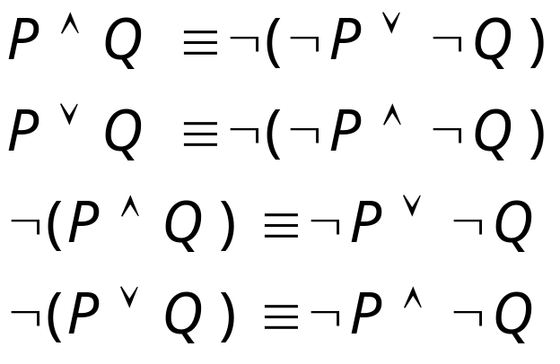
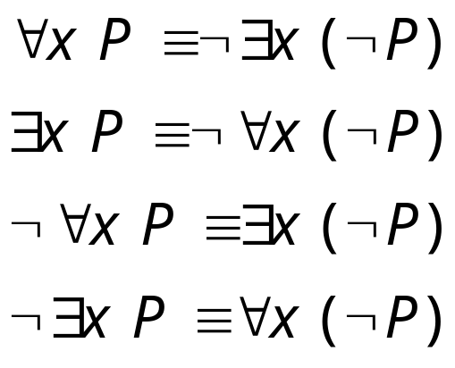
De Morgan’s Law for Quantifiers
De Morgan’s Rule
Generalized De Morgan’s Rule
Rule is simple: if you bring a negation inside a disjunction or a conjunction,
always switch between them
First two rules are for double negation
Second two rules are for single negation

Slide 80
Connections between Quantifiers
Applying DeMorgan’s rule 1:
Asserting that all x have property P is the same as asserting that does not exist any x that don’t have the property P
∀ x Likes(x, AI class) ⬄ ¬ ∃ x ¬ Likes(x, AI class)
In effect:
- ∀ is a conjunction over the universe of objects
- ∃ is a disjunction over the universe of objects
Thus, DeMorgan’s rules can be applied

Slide 81
Nested Quantifiers

Slide 82
Nested Quantifiers
A) Quantifiers are of the same type
Consecutive universal quantifiers - ∀ x ∀ y

Slide 83
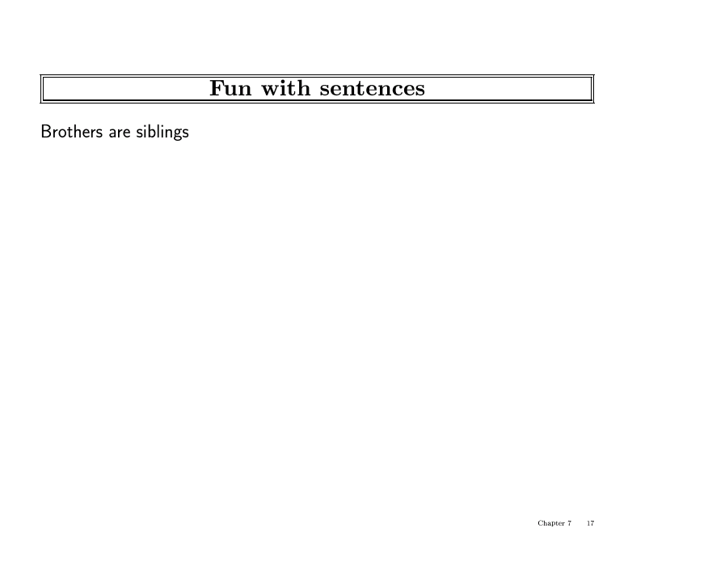

Slide 84
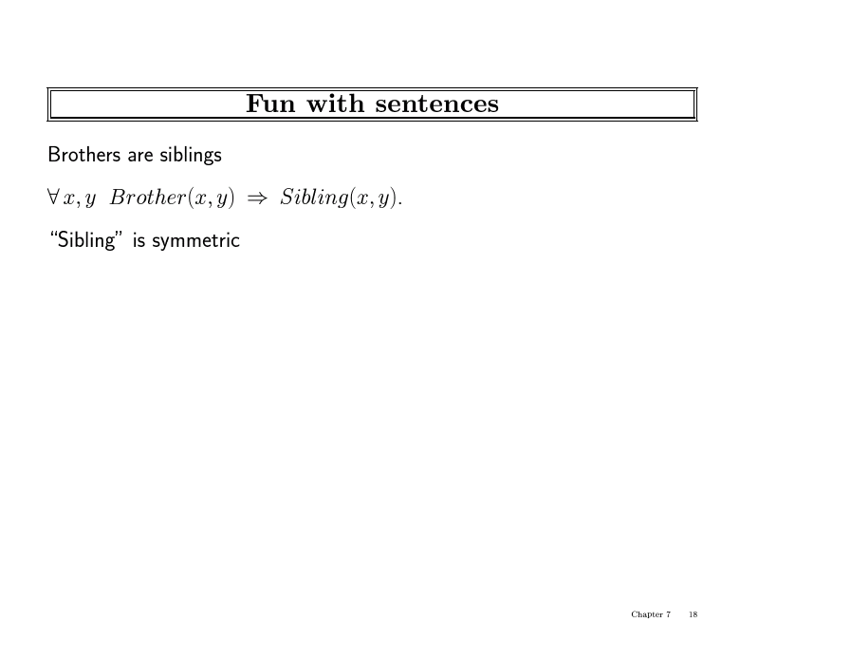

Slide 85
Translation
Sibling is symmetric
∀ x ∀ y Sibling(x,y) ⇔ Sibling (y,x)
∀ x ,y Sibling(x,y) ⇔ Sibling (y,x)

Slide 86
Nested Quantifiers
A) Quantifiers are of the different type
Assume:
  Variables x and y denote people
  A predicate Loves (x,y) denotes: “x Loves y”
1. Everybody loves John
∀ x Loves(x, John)

Slide 87
Nested Quantifiers - Combining Quantifiers
2. Everybody loves somebody
∀ x ∃ y Loves(x,y)
  For everyone (“all x”) there is someone (“y”) that person loves
3. There is someone who is loved by everyone
y ∀ x Loves(x,y)
- there is someone (“y”) who loves everyone

Slide 88
Nested Quantifiers - Combining Quantifiers
4. There is somebody who John does not love
∃ y ￢ Loves(John,y)
5. There is somebody whom no one loves
y ∀ x ￢ Loves(x,y)
Note: Clearer with parentheses
1. ∀ x (∃ y Loves(x,y) ) : ∀ x (P) : everyone in the world has property P
2. ∃ y ( ∀ x Loves(x,y) ) : ∃ y (P) : someone in the world has property P
3. Do not use same variable name for different quantifiers. Use a different variable name for a different quantifier

Slide 89
Order of quantifiers
Order of quantifiers of the same type does not matter
For all x and y, if x is a parent of y then y is a child of x
∀ x, y Parent(x,y) => Child(y, x)
∀ y, x Parent(x,y) => Child(y, x)
Order of different quantifiers changes the meaning
∀ x ∃ y Loves (x,y)

Slide 90
The Kinship Domain

Slide 91
Assumptions
Objects: people
Properties: gender
  Male ( x), Female (x)
Relations: parenthood, brotherhood, marriage
  Parent ( x, y), Brother ( x, y), Spouse ( x, y)
Functions: Mother (one for each person x)
  Mother(x)

Slide 92
The kinship Domain
Male and female are disjoint categories
∀ x Male (x) ⇔ ¬ Female (x)
Parent and child relations are inverse
∀ x, y Parent(x,y) ⇔ Child(y, x)
A grandparent is a parent of parent
∀ g, c grandparent(g, c) ⇔ ∃ p Parent (g, p) ^ Parent (p, c)
A sibling is another child of one’s parents
∀ x, y Sibling (x, y) ⇔ (x ≠ y) ^ ∃ p Parent (p, x) ^ Parent (p, y)

